Slide 1
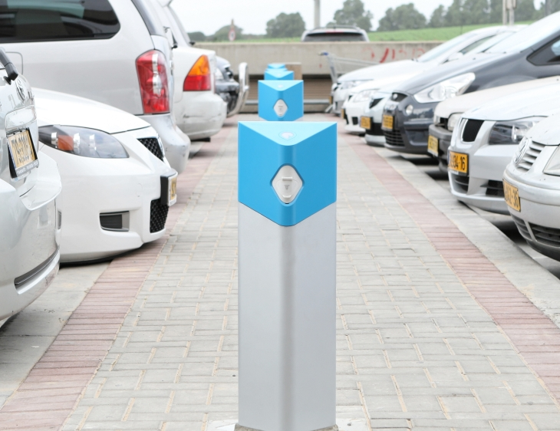
The College of Design, Engineering and Commerce and the Masters in Sustainable Design
Designing the Fueling Station of the Future
Source: abetterplace.com

Slide 2
Why is MSSD presenting?
Demonstrate one approach to work with DEC’s mission

Slide 3
Others working on this project
School of Architecture
Claudia Phillips
Susan Frosten
Rob Fleming
Robert Fryer
School of Design and Media
Gotz Unger
Tod Corlett
Hy Zelkowitz
Frank Baseman
Maribeth Kradel-Weitzel
Neha Agarwal
School of Engineering and Textiles
Muthu Govindaraj
K. Drevik
School of Business
Harvey Lermack
Sue Christoffersen
Stephen Spinelli
School of Liberal Arts
Tom Schrand

Slide 4
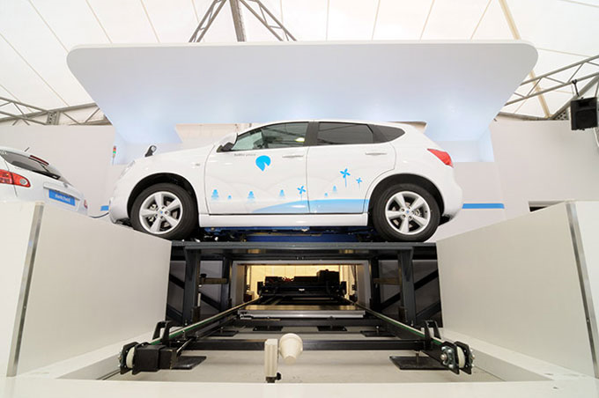
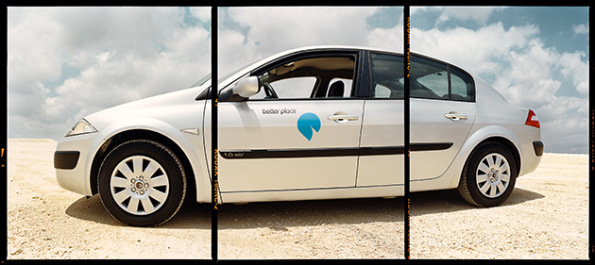
What is the Fueling Station Project?
Corporate Design Foundation Statement:
Design and develop a fueling station (or chain) for alternative fuel vehicles :
prototype
viable business model
The station should also be:
a public demonstration project of sustainable design for a service business
a sustainable business practice
a public demonstration of energy conservation and the use of alternative energy sources
Source: abetterplace.com
Source: abetterplace.com

Slide 5
How did the MSSD work with the project?
Value Proposition MSSD Program
Trans-disciplinary Learning
Equity and Diversity
Integrated Design Education
Design/Quantify/Build
Activism and Leadership
Enterprise and Entrepreneurship
A Center of Green Activity
Source: philau.edu/green

Slide 6
How did the MSSD work with the project?
Value Proposition MSSD Program
Trans-disciplinary Learning
Equity and Diversity
Integrated Design Education
Design/Quantify/Build
Activism and Leadership
Enterprise and Entrepreneurship
A Center of Green Activity
College of DEC
A goal of the Philadelphia University Strategic Plan is the establishment of a distinctive, collaborative curriculum around design, engineering and commerce that is focused on achieving innovation.

Slide 7
How did the MSSD work with the project?
Studio 1
Studio 2
Experts
Business Branding
Civil Engineer
Entrepreneur
Builder / Cost estimator
Architect
Energy Modeler

Slide 8
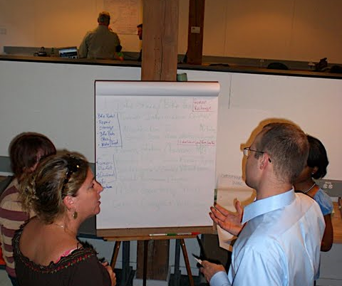
How did the MSSD work with the project?
Week
1
2
3
4
5
6
7
8
Studio 1
Studio 2

Slide 9
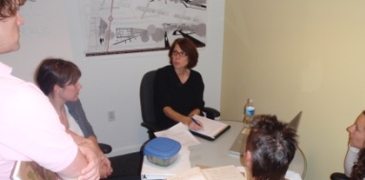
How did the MSSD work with the project?
Week
1
2
3
4
5
6
7
8
Studio 1
Studio 2

Slide 10
How did the MSSD work with the project?
Big Mamma
Studio
Studio 1
Studio 2
Site 1
Urban
Site 2
Semi-urban
Site 3
Suburban
Site 4
Turnpike
2010
2030
Pool of ideas

Slide 11
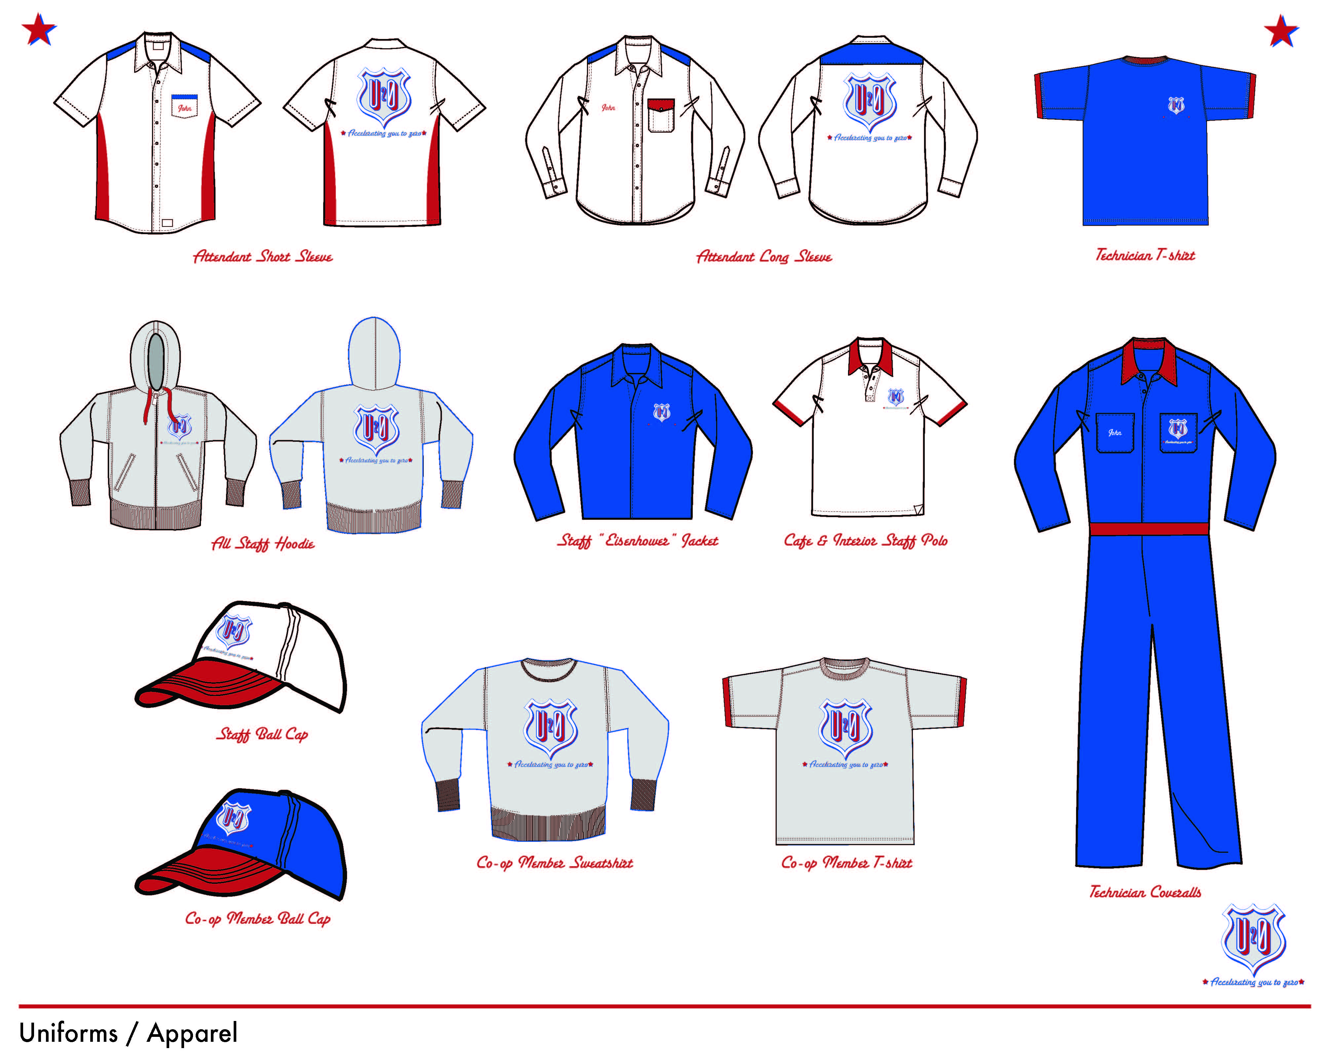
How did the MSSD work with the project?
1
2
3
4
5
6
7
8
9
10
11
Pool of ideas

Slide 12
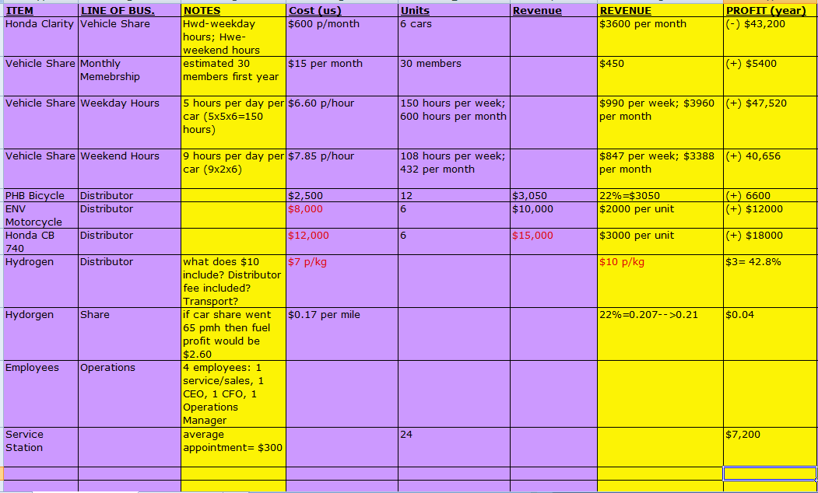
Student Work In-Progress
Business Concept Flow Diagram
Rough Business Budget
Water Consumption Calculations
Rough Business Budget
Facility Energy Model

Slide 13
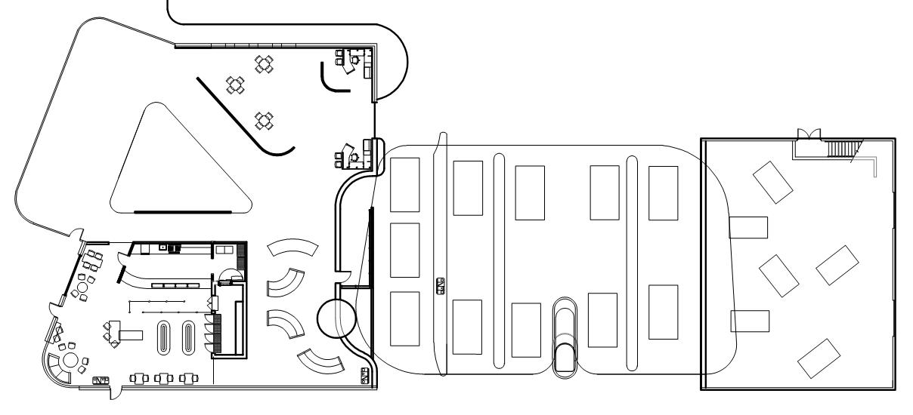
Student Work In-Progress

Slide 14
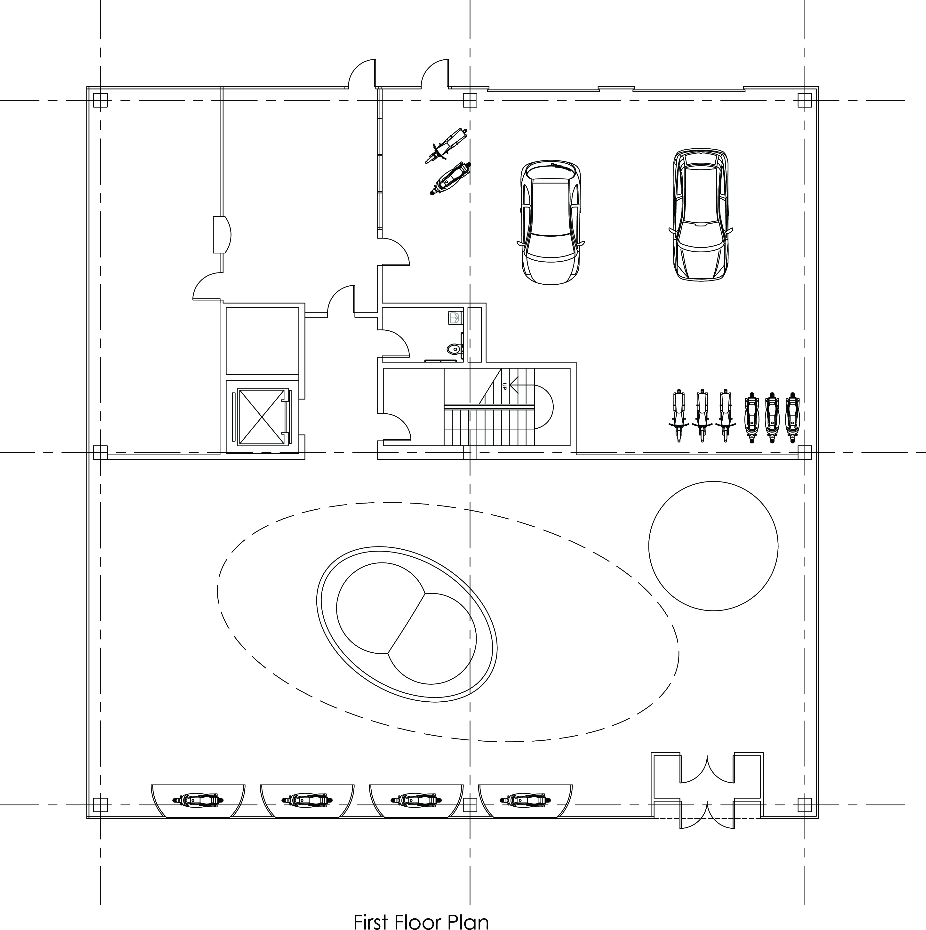
Student Work In-Progress

Slide 15
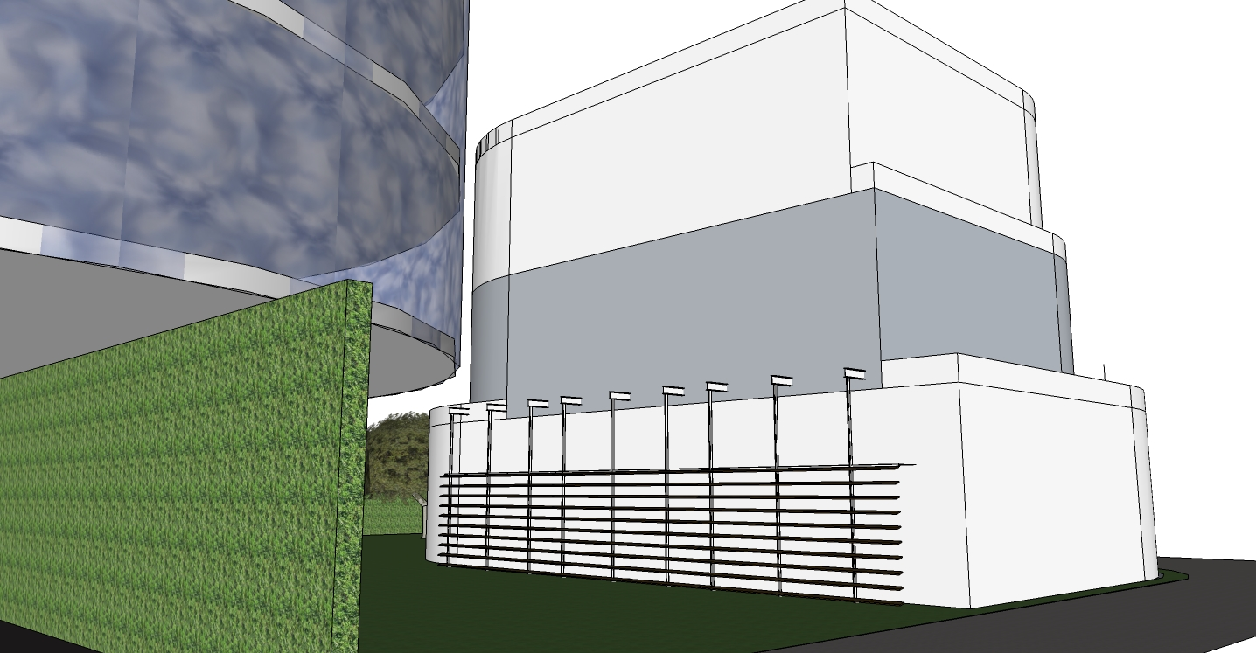
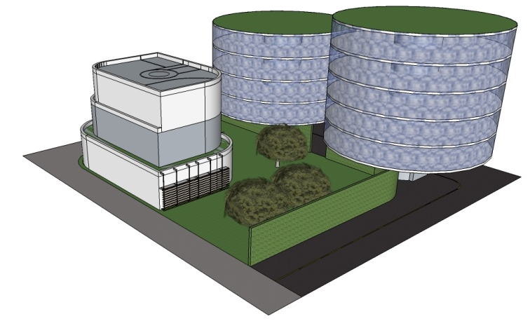
Student Work In-Progress

Slide 16
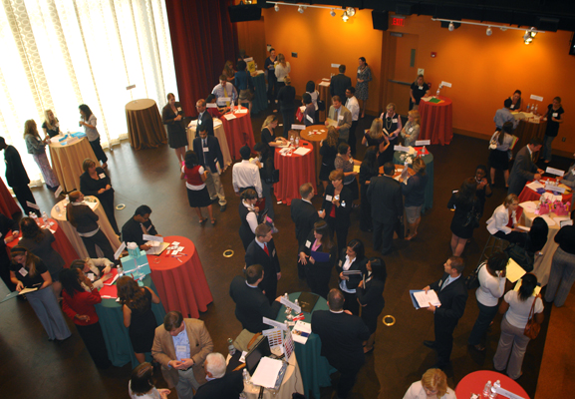
Information Transfer
Please Come See
Mon Nov 2nd
Kanbar Performance Space
MSSD AND DESIGN 9 FROM ARCHITECTURE

Slide 17
Thank you

